Slide 1
Local Electricity Project: DIY Wind Turbine
SAFETY NOTE: Wind turbines can be extremely dangerous and should never be installed near highly populated areas. Always double check your work and make sure all fasteners use locking nuts or threadlocker.

Slide 2
Introduction
This is a guide to making your own low cost wind turbine using readily available parts, tools and labour.
Most of the materials used were sourced from my local hardware store (Bunnings, Australia), with the exception of the treadmill motor, which was bought off eBay for $40AUD.
I tested the motor by turning it in a drill press and measured the voltage output at different speeds with a dummy load and datalogger, achieving 20W at 400RPM.
This wind turbine was built and tested with a maximum output of 20W, although more detailed analysis is required to determine the power curve.
Tools and materials required are listed below, but it should be noted that the instructions can be altered to suit your own circumstances.
We have split tools into those that are required, and those that are recommended for better precision, which is particularly important with the blades.

Slide 3
Next Steps
This is a first attempt at creating a wind turbine that fits our requirements and a set of instructions to go with it. While we are reasonably happy with the success we acknowledge that there is plenty of room for improvement!
Tower/foundation – we have not yet addressed how to mount the tower, we will be creating some guidelines on this soon.
Furling – a good wind turbine should have a system to stop it spinning too fast in high winds. We will be incorporating a passive furling system into the next instructions.
Power curve – while we have done some basic testing in the wind, we will be logging the power output at various wind speeds using an anemometer to develop a detailed power curve which will allow us to incorporate improvements and test their effect.
More power – ideally we want to achieve 50W in moderate wind conditions. This will require a new motor and we are on the lookout!
PVC – we appreciate that PVC is not ideal for applications in direct sunlight. This can be rectified by painting with paint that protects from UV rays, but we are looking to minimise use of PVC with our next design.
Better instructions – our aim is to create instructions that anyone can follow. We’d love to know how you found them and if you have any improvements regarding the instructions or the design then please let us know at www.localelectricity.org

Slide 4
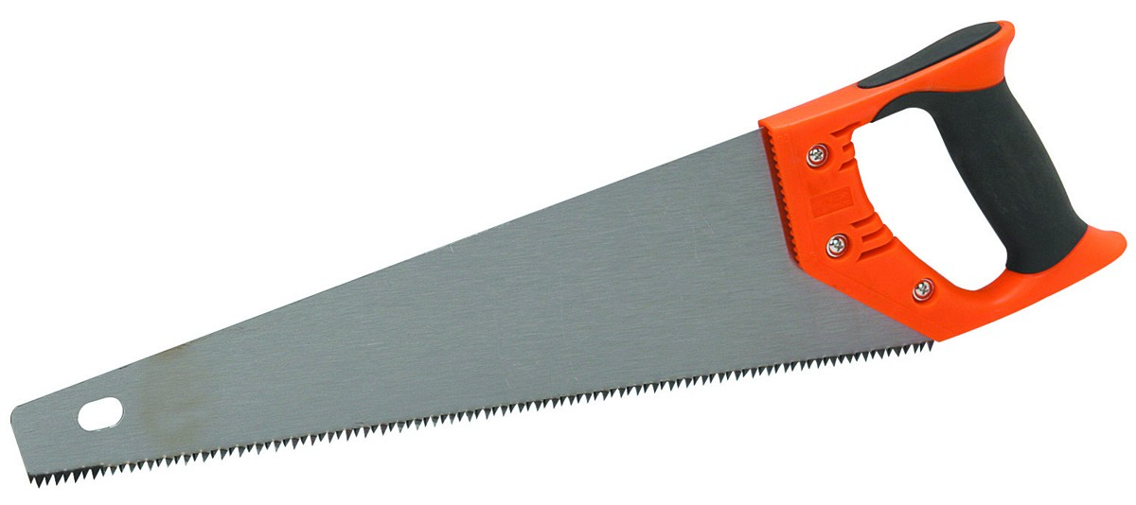
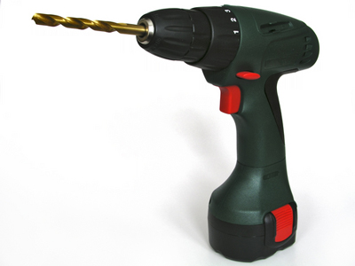
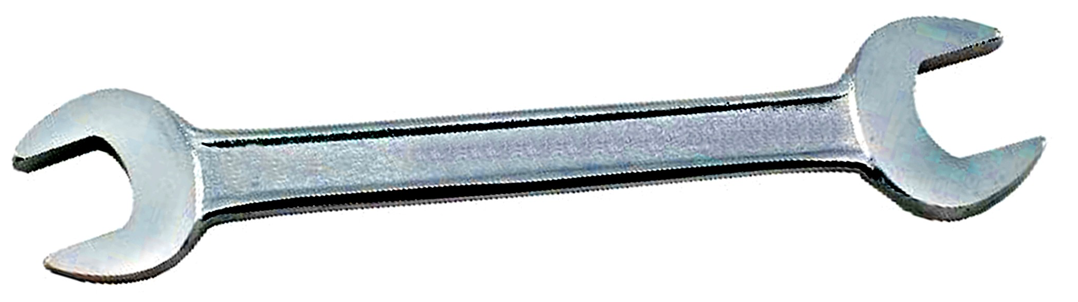
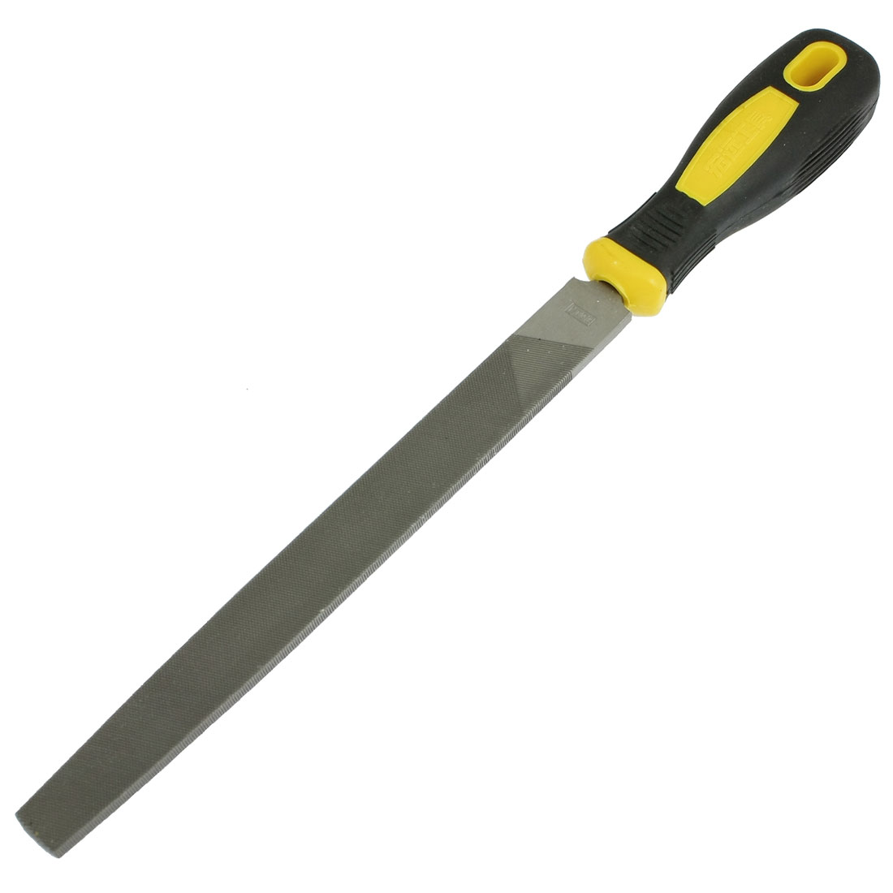
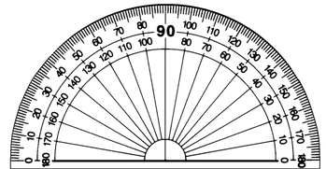
Tools Required
Hand saw
Hand drill
Spanners (various sizes)
File
Protractor

Slide 5
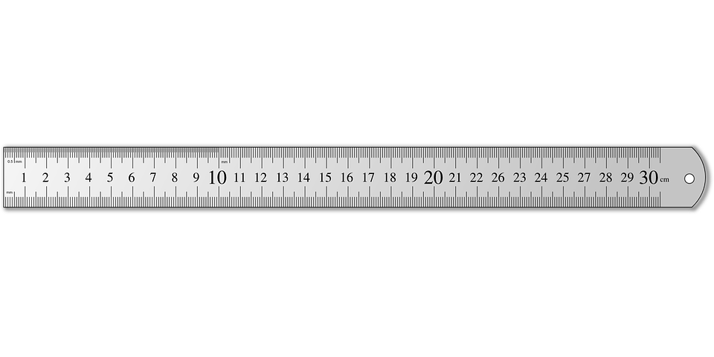
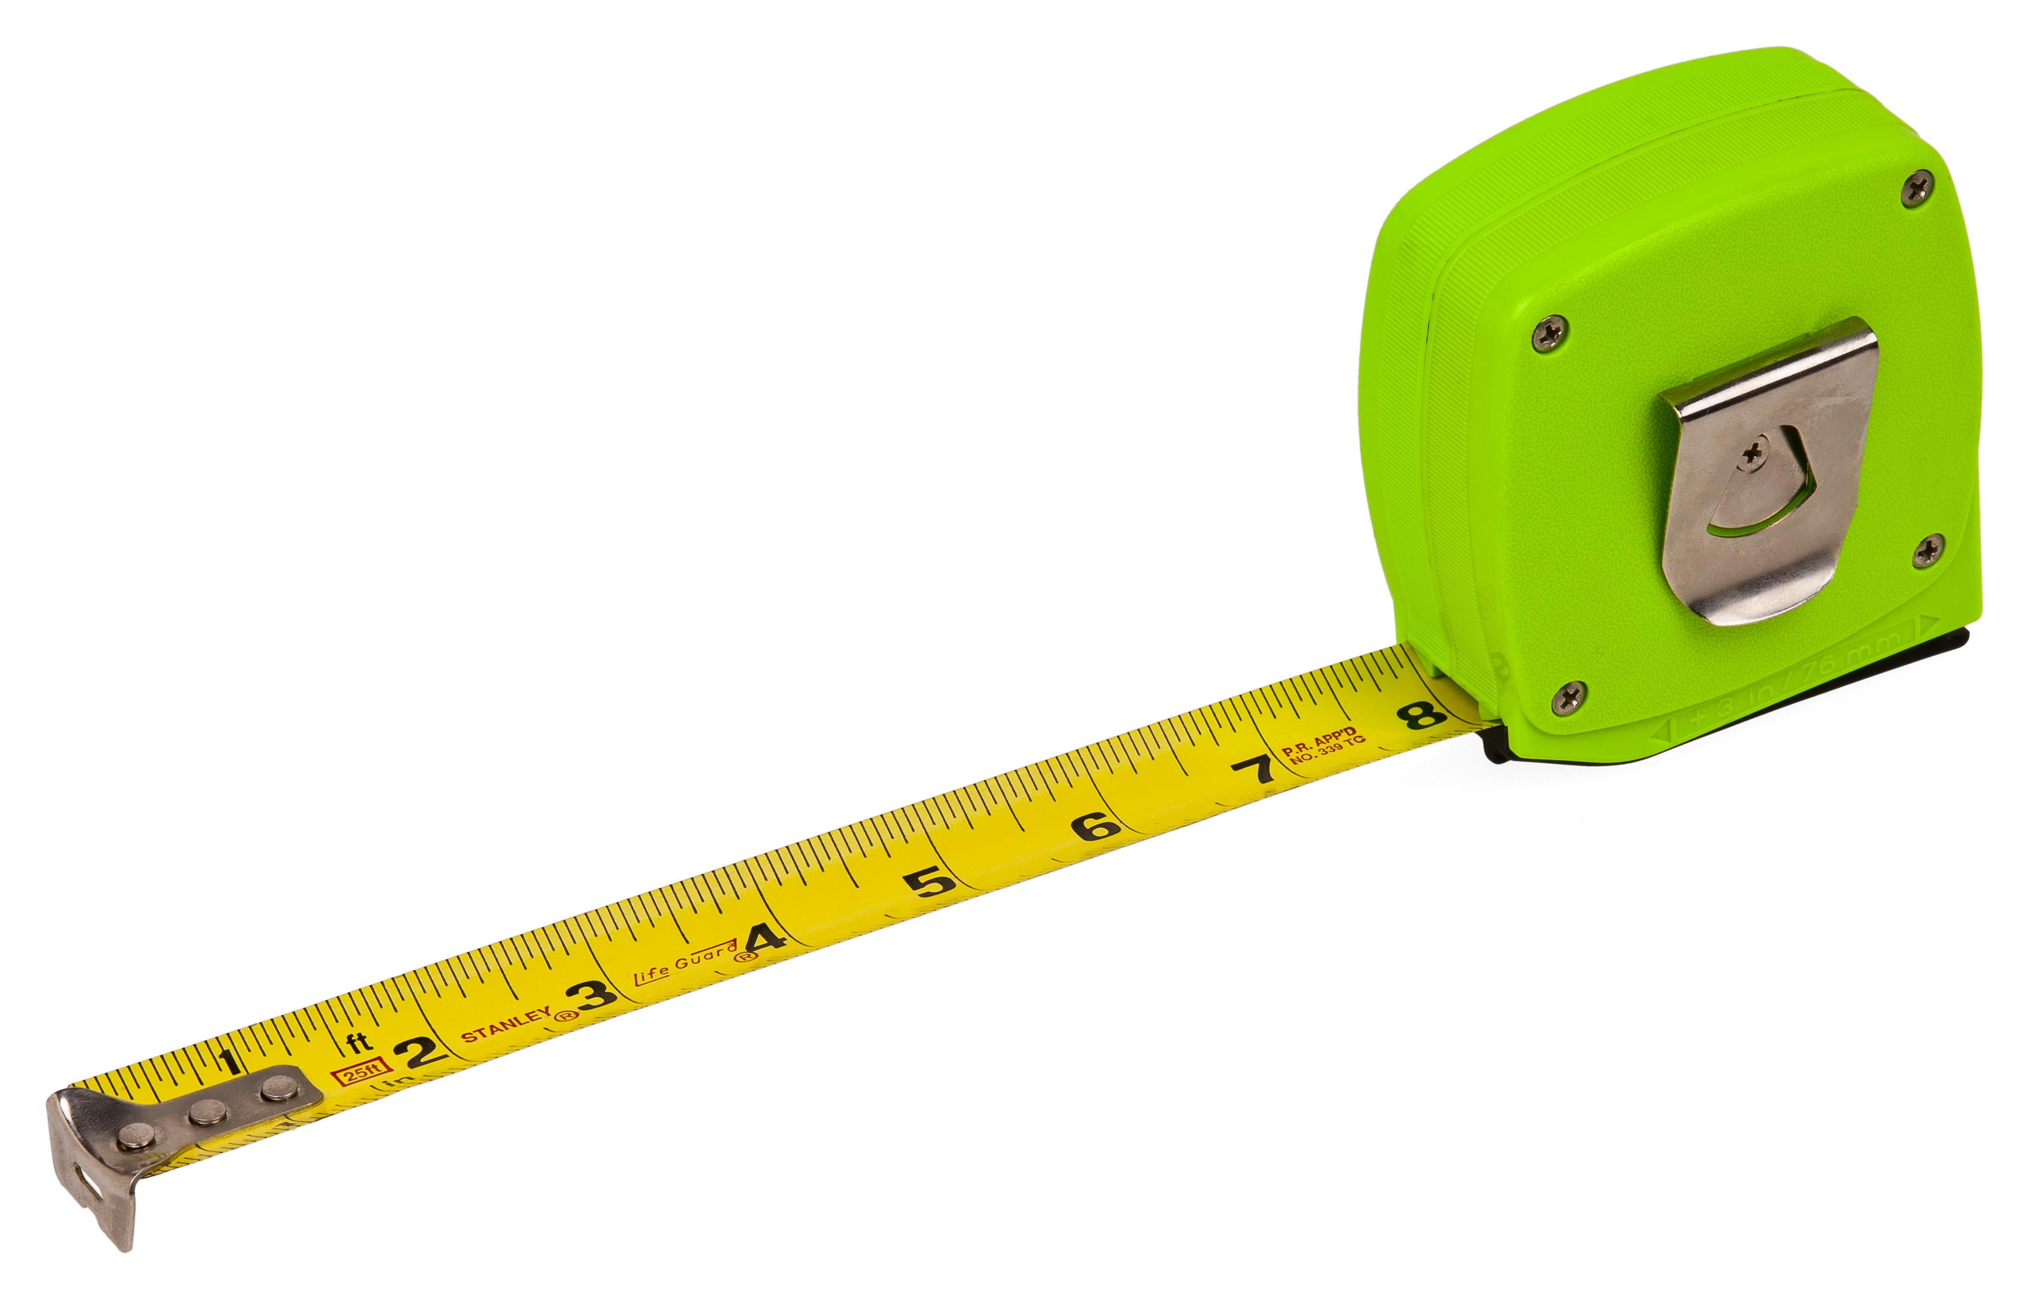
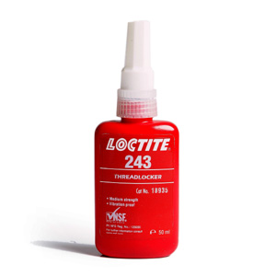
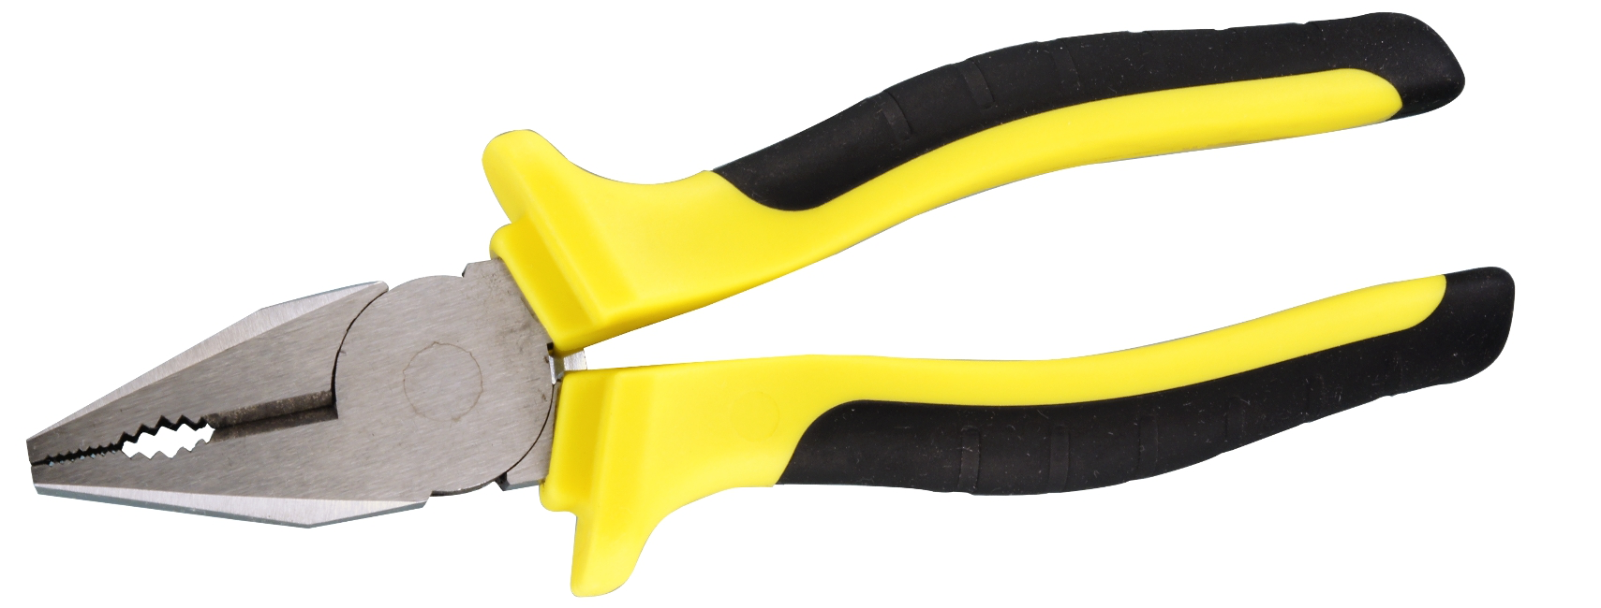
Tools Required
Ruler
Tape measure
Threadlock
Pliers

Slide 6
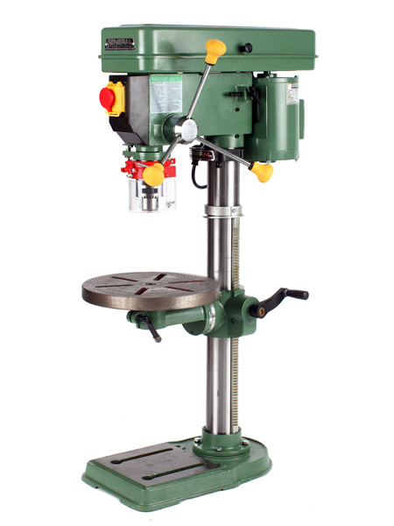
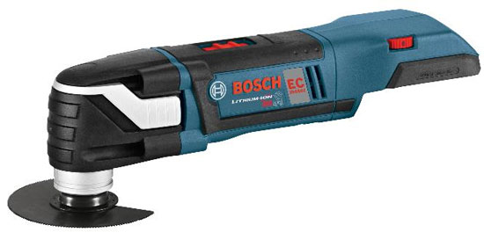
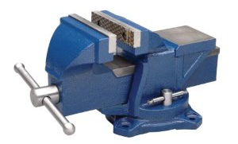
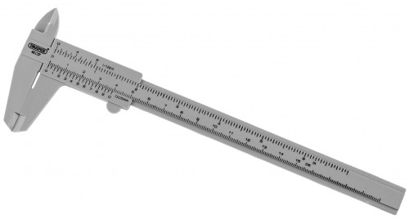
Optional Tools
Drill press
Power saw
Bench vice
Callipers

Slide 7
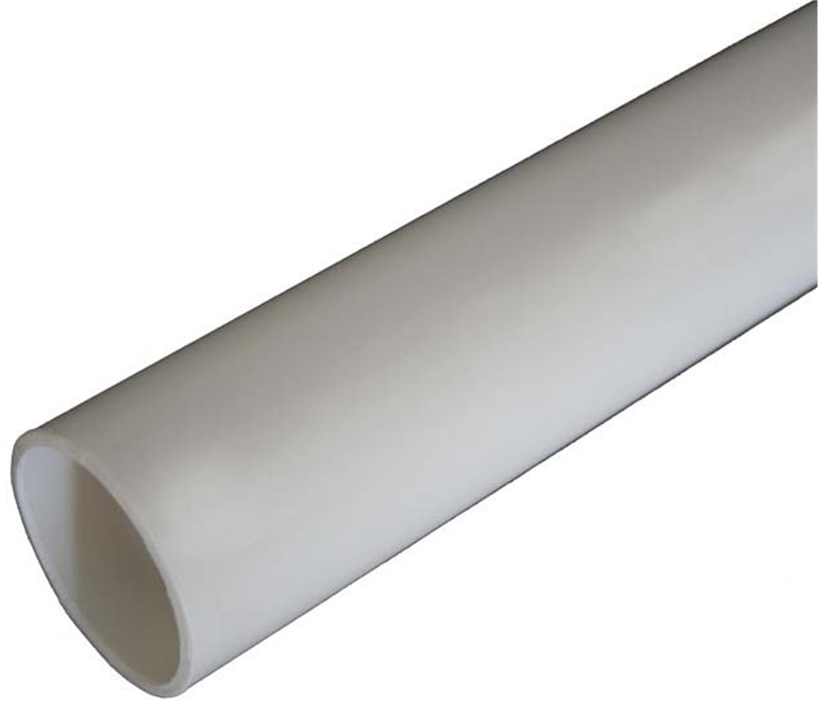
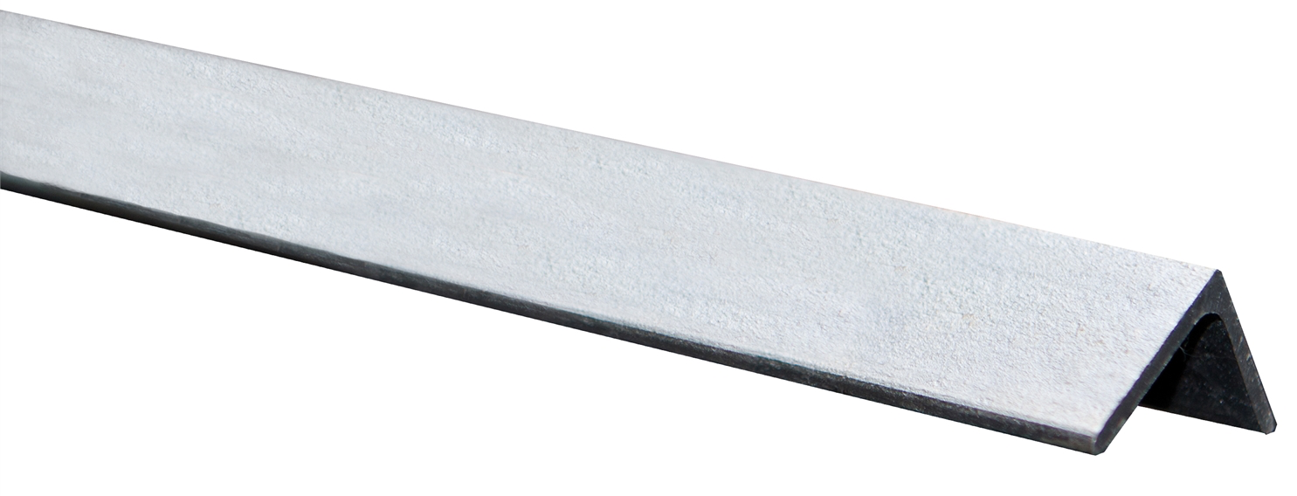
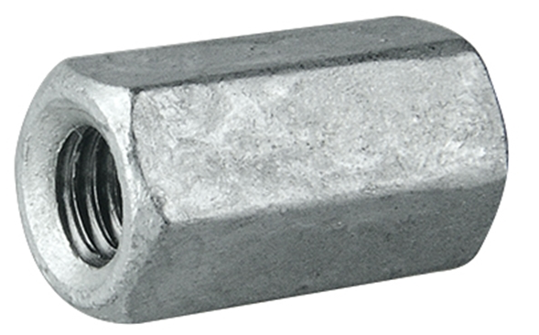
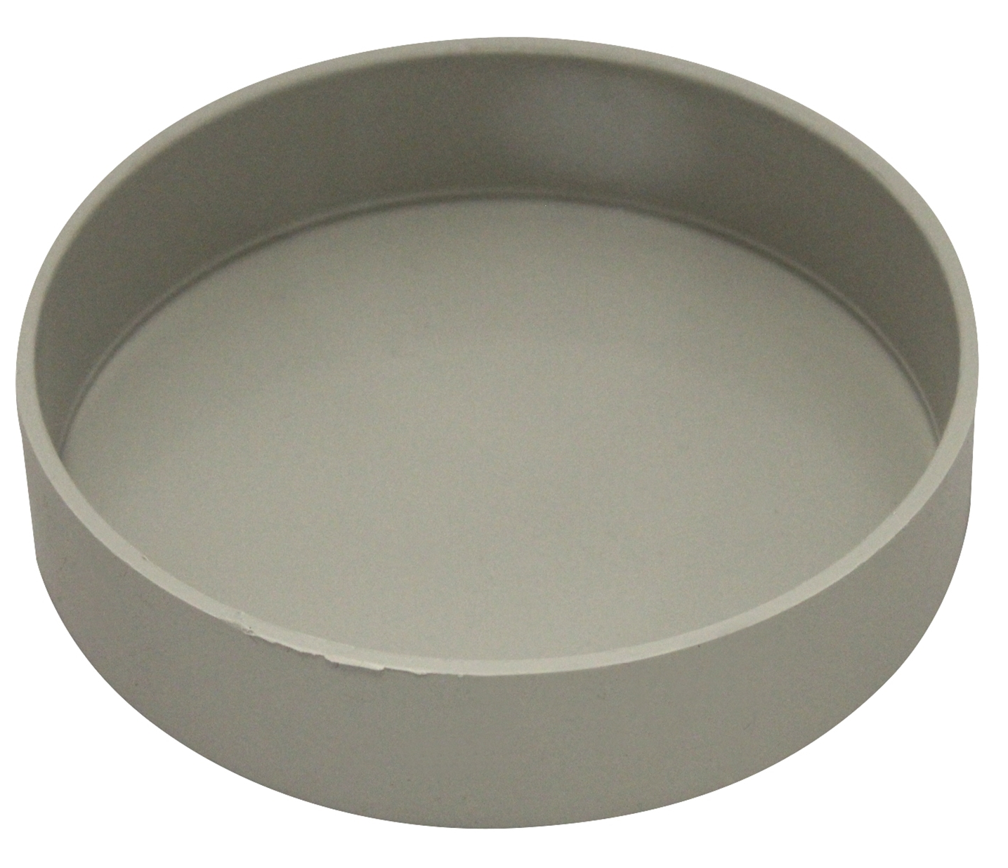
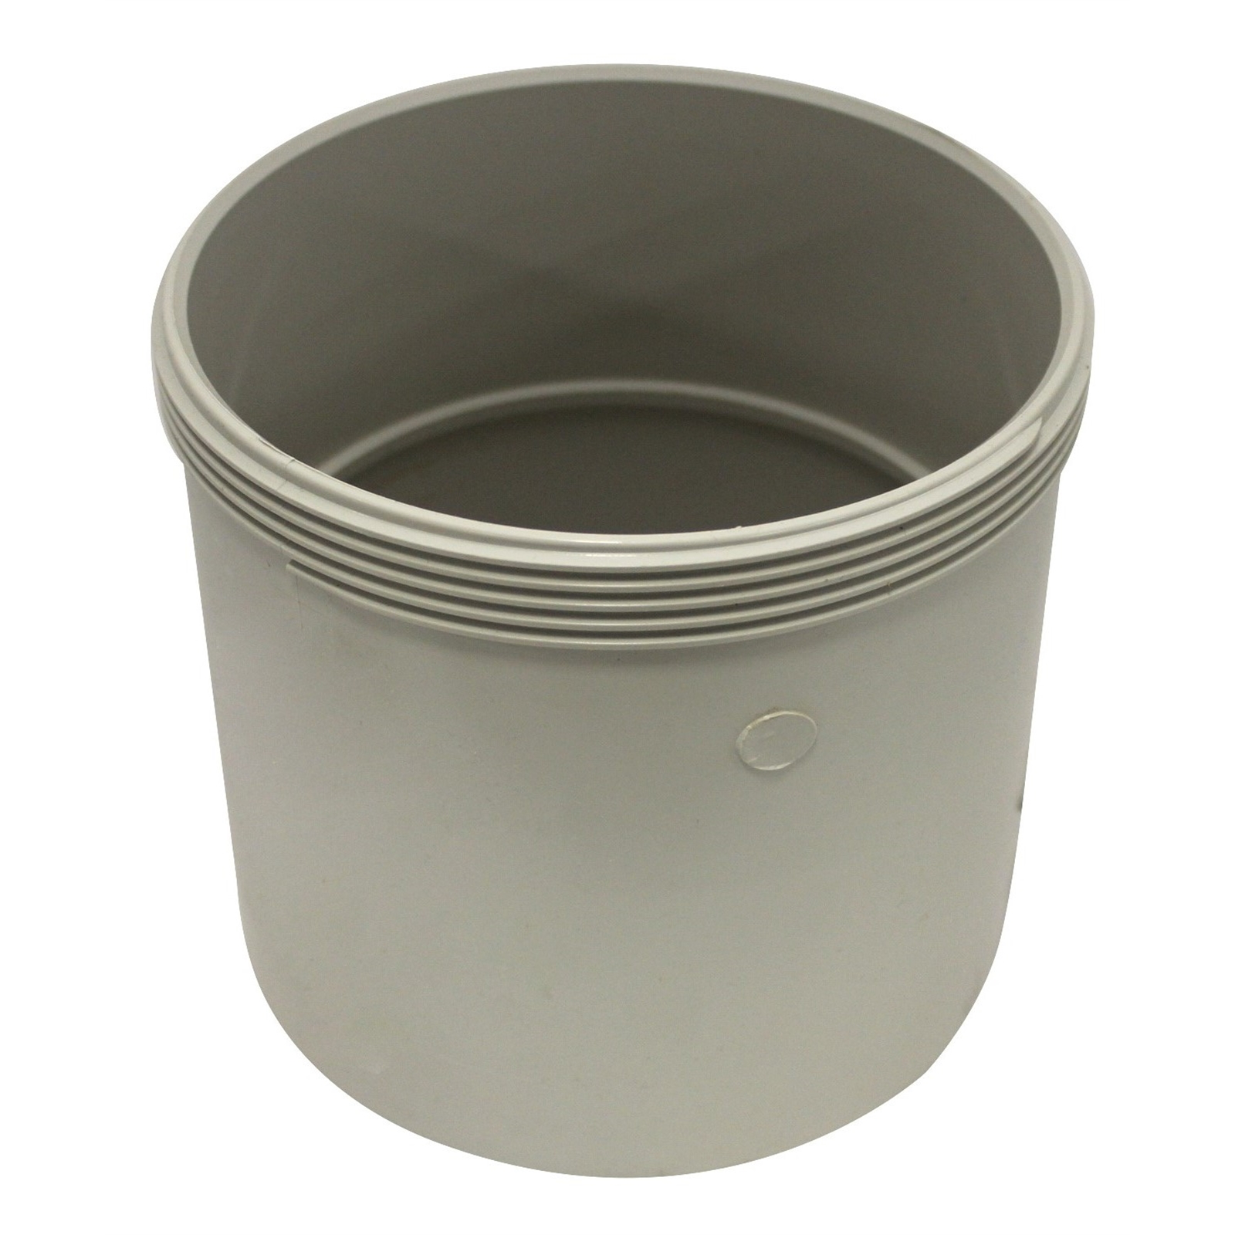
Materials
90mm x 1m PVC pipe | x1
12x12x1.4mm Angle Iron (0.5m long) | x1
M16 x 60mm hex coupler | x1
100mm PVC end cap | x1
150mm PVC threaded access coupling | x1

Slide 8
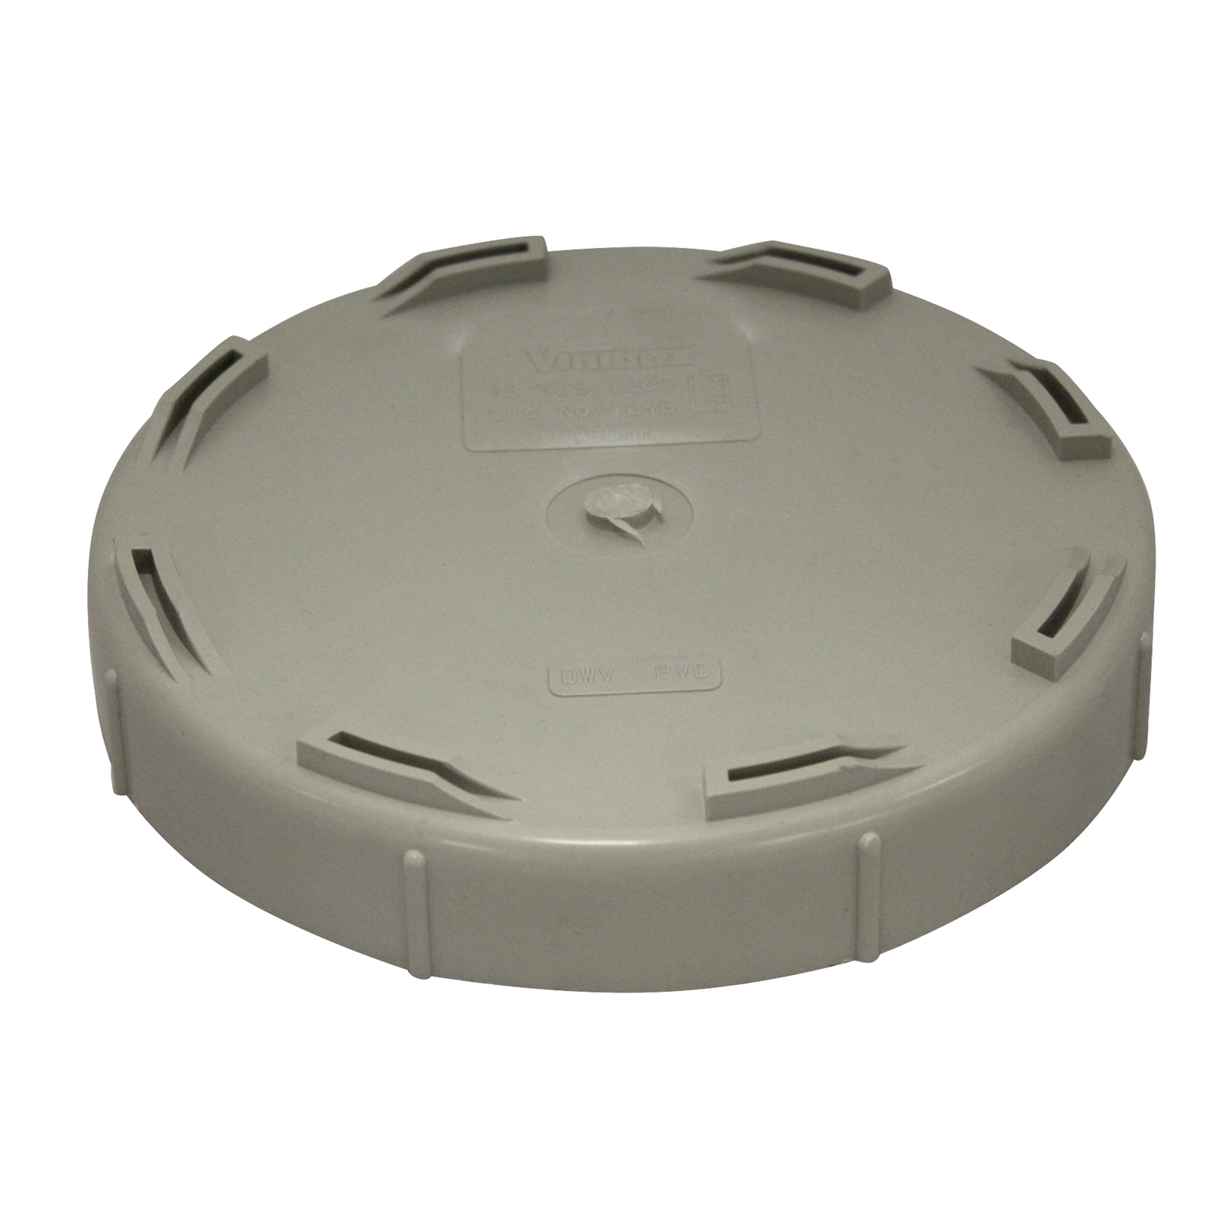
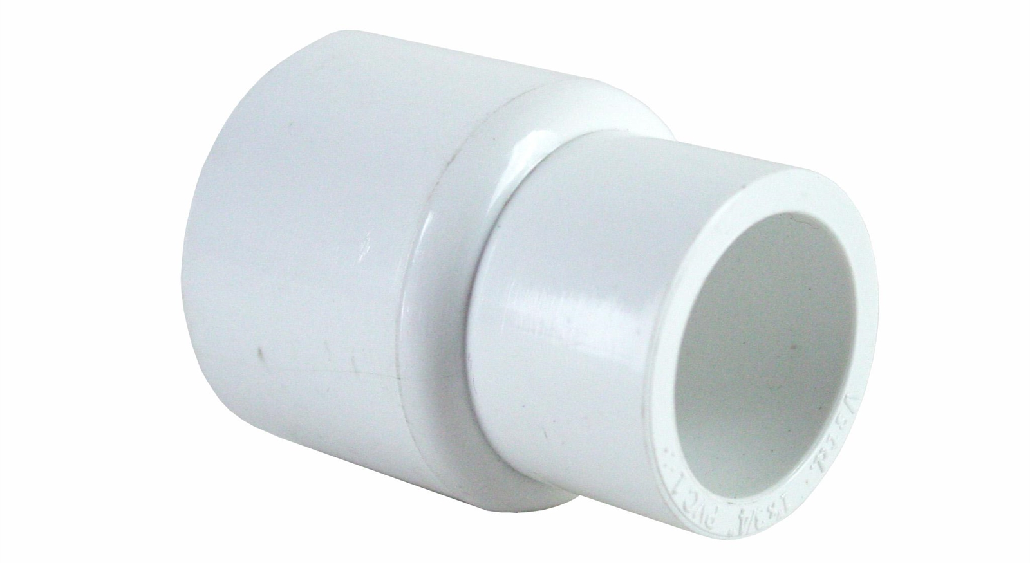
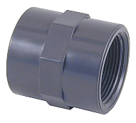
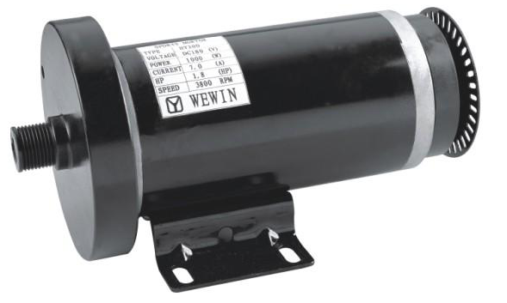
Materials
150mm PVC threaded end cap | x1
150mm PVC end cap | x1
20mm to 15mm PVC reducer | x1
15mm PVC male thread adapter | x1
Treadmill motor | x1

Slide 9
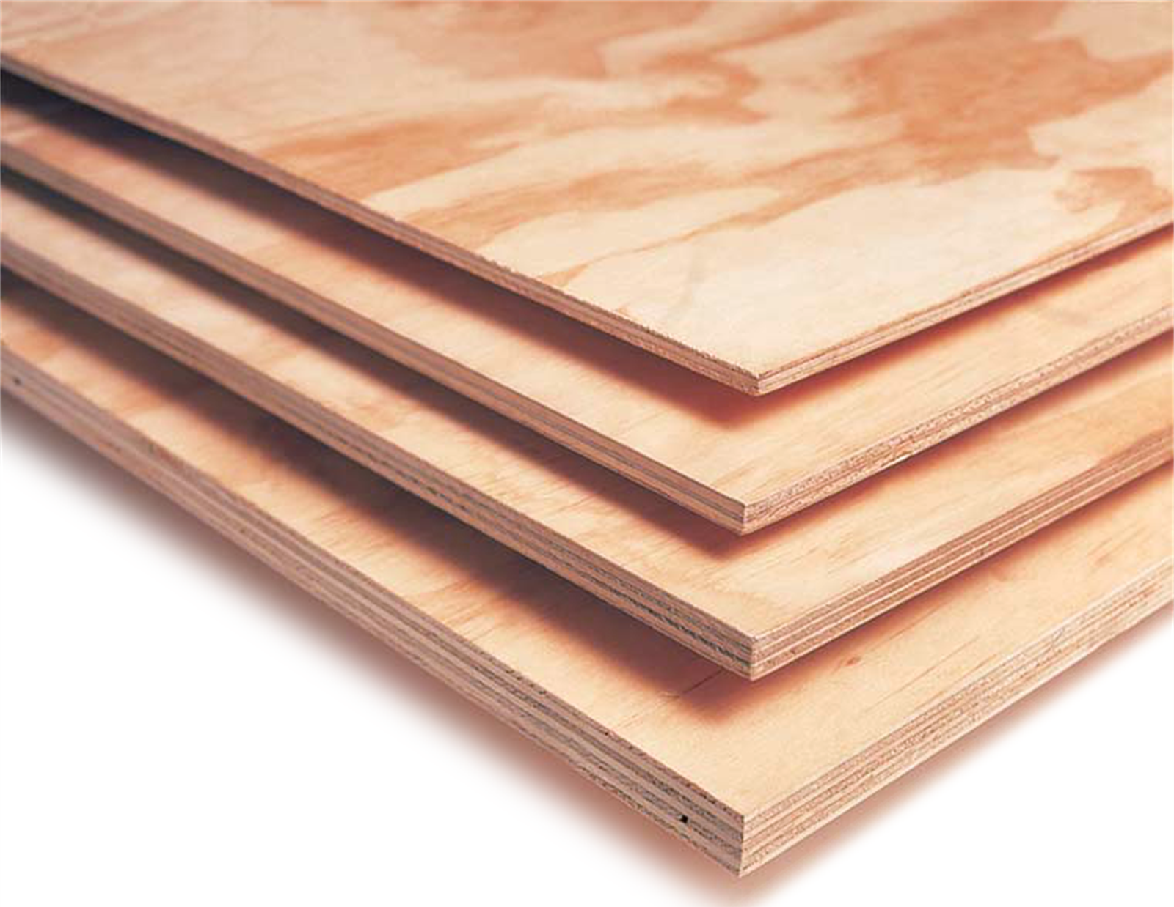
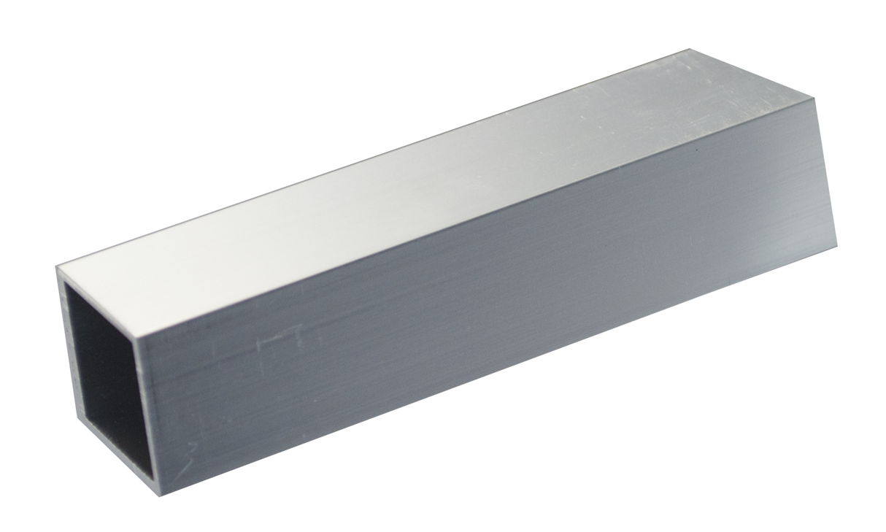
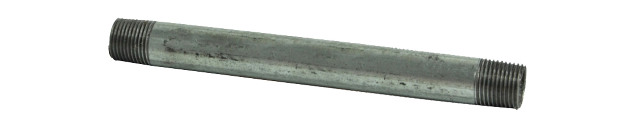
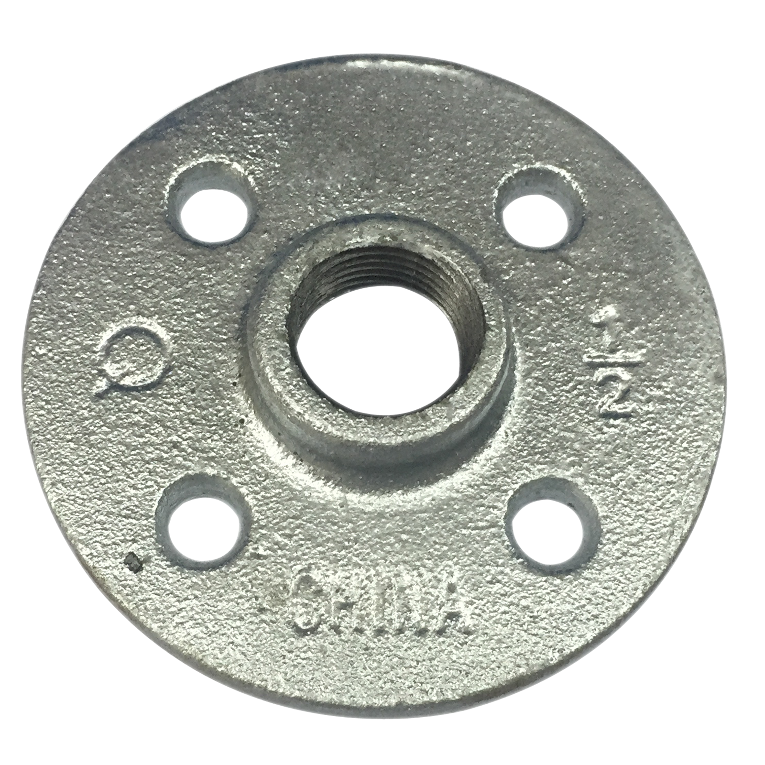
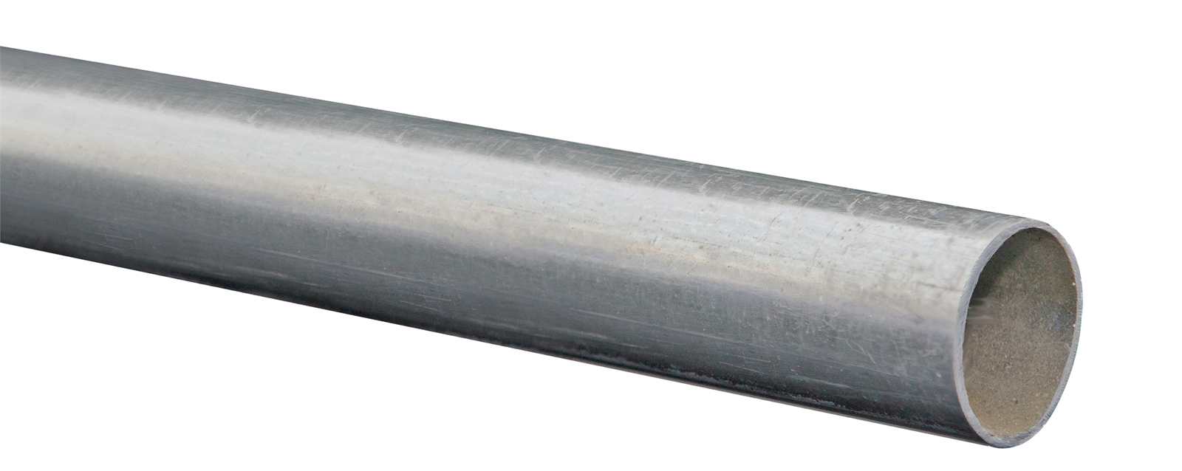
Materials
300x300x5mm plywood | x1
19mm aluminium box section (500mm long) | x1
15mm x 200mm pipe | x1
15mm pipe flange | x1
31.8x1.2mm steel tubing (3m long) | x1

Slide 10
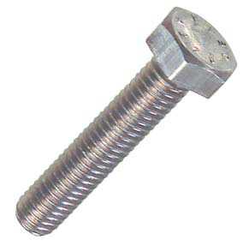
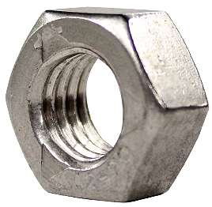
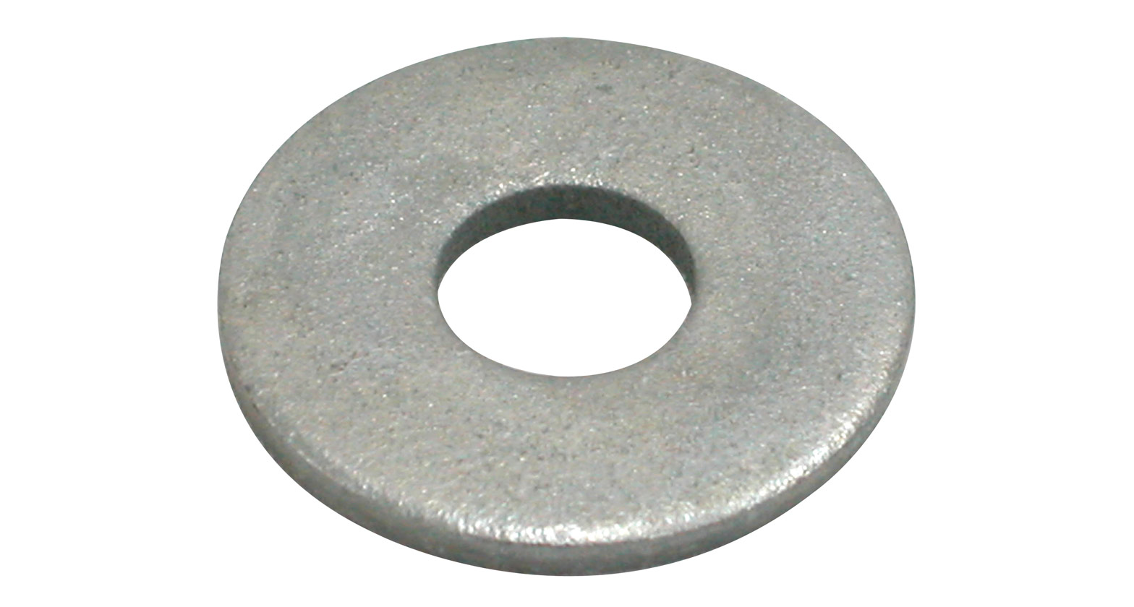
Fasteners
Bolts: M16x100mm M7x20mm M5x25mm M5x35mm 0.5”x1.5” | x1 x4 X10 X4 x4
Nuts: M16 M7 M5 0.5” | x1 x4 X14 x4
Washers: M7 M5 0.5” | x4 X14 x4

